Slide 1
CHAPTER OBJECTIVES
Clearly understand how the requirements definition determines data design
Introduce dimensional modeling and contrast it with entity-relationship modeling
Review the basics of the STAR schema
Find out what is inside the fact table and inside the dimension tables
Determine the advantages of the STAR schema for data warehouses

Slide 2
FROM REQUIREMENTS TO DATA DESIGN
The requirements definition completely drives the data design for the data warehouse.
Data design consists of putting together the data structures.
Logical data design includes determination of the various data elements that are needed and combination of the data elements into structures of data.
Logical data design also includes establishing the relationships among the data structures.
The results of the requirements gathering phase is documented in detail in the requirements definition document.
An essential component of this document is the set of information package diagrams.
The information package diagrams form the basis for the logical data design for the data warehouse.
The data design process results in a dimensional data model.

Slide 3
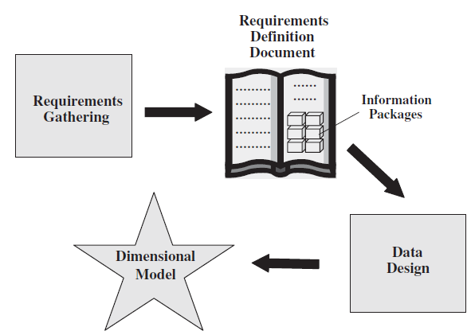
FROM REQUIREMENTS TO DATA DESIGN
Figure 10-1 From requirements to data design.

Slide 4
Information package
Information Packages are a novel approach to determine and document information requirements for a data warehouse.
Requirements are identified based on business dimensions, which are perspectives or areas critical to business performance.
These dimensions and the corresponding measurements are captured and stored in the data warehouse, forming an information package for a specific subject.
  Business Dimensions:
During the requirements collection phase, end users identify key measurements relevant to their departments.
Users also provide insights for integrating multiple information sources for strategic decision-making.
Managers conceptualize business operations through various dimensions and evaluate business performance accordingly.
  Hierarchies and Categories:
Hierarchies enable drill-down and roll-up analysis, providing depth in data exploration.
Important non-hierarchical data elements are termed categories.
    - For example, a holiday flag is a category useful for analyzing sales performance on holidays.

Slide 5
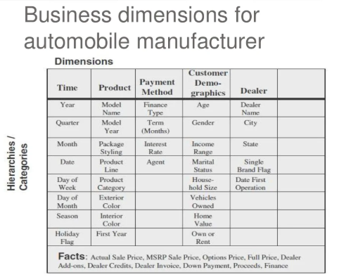
Figure 10-3 Formation of the automaker dimension tables.

Slide 6
Dimensional Modeling Basics
Dimensional modeling: is a database design technique to support business users to query data in data warehouse. The dimensional modeling is developed to be oriented around query performance and easy of use .
In dimensional modeling, there are two important concepts: facts and dimensions.
  Facts are also known as business measurements. Facts are normally (but not always) numeric values which could be aggregated. Example of fact could be number of units sold.
  Dimensions are called context. Dimensions are business descriptors which specify the facts, for example product name, brand, quarter, etc. are components of dimensions.

Slide 7
Dimensional modeling process
The dimensional data model is built based on star schema with a fact table at the center surrounded by a number of dimension tables. The following four-step process is commonly used in dimensional modeling design:
  Select the business process
  Declare the Grain
  Identify the dimensions
  Identify the Fact
Let’s examine each step in the modeling process in a great detail.

Slide 8
Identify the dimensions :
in the third step, we add number of dimensions that represents all possible descriptions which take on single values in the context of each fact in the fact table. Date, time, product, customer, store… are several good examples of common dimensions.
Identify the facts :
in the last step, we select the numeric facts that will be loaded into each fact table row. To identify the fact we need to answer the question “What are KPIs of the business process?” or “What are we measuring?”

Slide 9
Benefits of dimensional modeling
Dimensional model have proved to be more understandable : in dimensional model, data is grouped into coherent dimensions that make it easy to read and interpret by business users.
Dimensional model allows boost query performance : the dimensional model is more de-normalized therefore it is optimized for querying. In addition, the predictable framework of a dimensional model allows database engine to make strong assumption about the data that will help to boost query performance.

Slide 10
Star Schemas
The basic building block used in dimensional modelling is the star schema.
A star schema consists of one large central table called the fact table, and a number of smaller tables called dimension tables which radiate out from the central table.
The fact table forms the “centre” of the star, while the dimension tables form the “points” of the star.
Astar schema may have any number of dimensions.

Slide 11
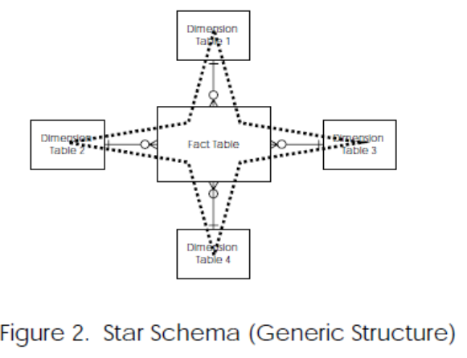
Star Schemas

Slide 12
Star Schemas :discuss
The fact table contains measurements (e.g. price of products sold, quantity of products sold) which may be aggregated in various ways.
The dimension tables provide the basis for aggregating the measurements in the fact table.
The fact table is linked to all the dimension tables by one-to-many relationships
The primary key of the fact table is the concatenation of the primary keys of all the dimension tables.
Features of star schema
  Central fact table
  Dimension tables
  star schema is denormalized, which means that redundancy is allowed I
  Star schema is designed to make OLAP queries simple and fast s
  The numerical data in the fact table is usually aggregated at different levels of granularity, such as daily, weekly, or monthly. This allows for analysis at different levels of detail.chema design to improve query performance

Slide 13
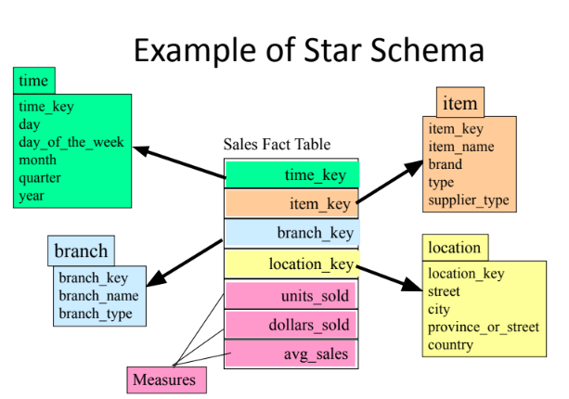

Slide 14
Snowflake Schema
The Snowflake schema is a type of star schema but a more complex model.
“Snowflaking” is a method of normalizing the dimension tables in a star schema.
The normalization eliminates redundancy
The result is more complex queries and reduced query performance.
Advantages:
Small saving in storage space
Normalized structures are easier to update and maintain
Disadvantages:
Schema less intuitive and end-users are put off by the complexity
Ability to browse through the contents difficult
Degrade query performance because of additional joins

Slide 15
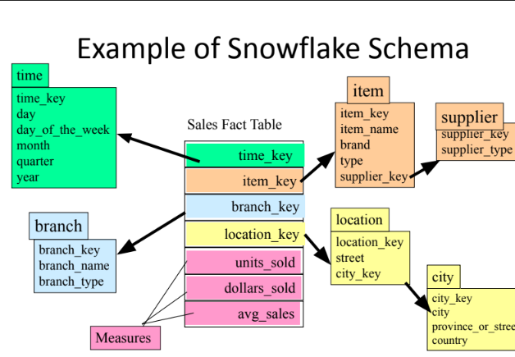

Slide 16
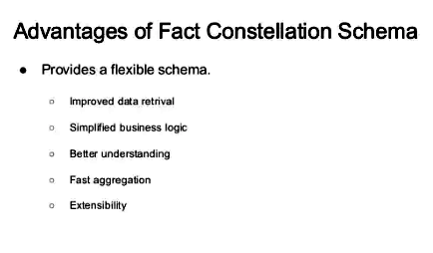
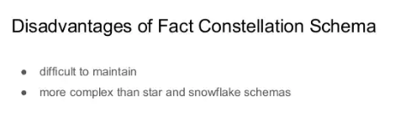

Slide 17
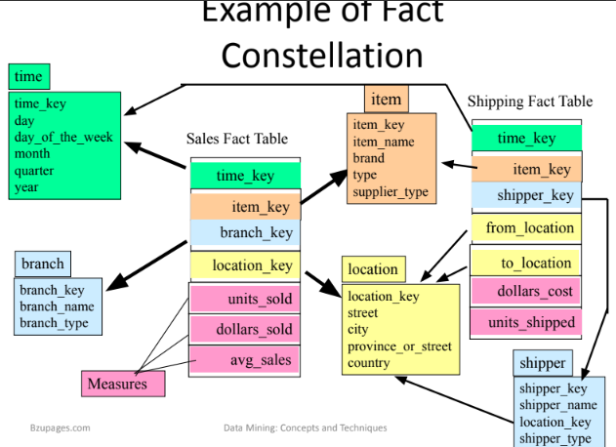

Slide 18
Fact table
Fact table is at the core of the star schema. Fact table stores measure of interests or facts. Normally facts are in numeric that can be aggregated, summarized or rolled up…
The fact table contains surrogate keys as a part of its primary key referring to the corresponding dimension tables. As shown in the diagram above, the FACT_SALES includes 1 fact called UNITS_SOLD.
A fact table is used in dimensional model in data warehouse design. It is often found at the center of a star schema or snowflake schema surrounded by dimension tables. Fact table consists of facts of a particular business process e.g. sale volume by month by product. Facts are also known as measurements or metrics. A fact table record capture a measurement or metric.

Slide 19
Types of fact tables
All fact tables are categorized by three most basic measurement events:
Transactional – Transactional fact table is the most basic one that each grain associated with it indicated as “one row per line in a transaction”, e.g., every line item on an invoice. Transactional fact table stores data of the most detailed level therefore it has high number of dimensions associated with.
Periodic snapshots - Periodic snapshots fact table stores data that is a snapshot in a period of time. The source data of periodic snapshots fact table is data from a transactional fact table where you choose period to get the output.
Accumulating snapshots – The accumulating snapshots fact table describes activity of a business process that has clear beginning and end. This type of fact table therefore has multiple date columns to represent milestones in the process. A good example of accumulating snapshots fact table is processing of a material. As steps towards handling the material are finished, the corresponding record in the accumulating snapshots fact table get updated.

Slide 20
Fact Table characteristics
The main characteristics of fact table are :
Concatenated Key:
  A row in the fact table relates to a combination of rows from all the dimension tables. In this example of a fact table, you find quantity ordered as an attribute. Let us say the dimension tables are product, time, customer, and sales representative .the row in the fact table must be identified by the primary keys of these four dimension tables. Thus, the primary key of the fact table must be the concatenation of the primary keys of all the dimension tables.

Slide 21
Fact Table characteristics
Data Grain:
  This is an important characteristic of the fact table. As we know, the data grain is the level of detail for the measurements or metrics. In this example, the metrics are at the detailed level. The quantity ordered relates to the quantity of a particular product on a single order, on a certain date, for a specific customer, and procured by a specific sales representative. If we keep the quantity ordered as the quantity of a specific product for each month, then the data grain is different and is at a higher level.

Slide 22
Fact Table characteristics
Fully Additive Measures:
Such measures are known as fully additive measures. Aggregation of fully additive measures is done by simple addition. When we run queries to aggregate measures in the fact table, we will have to make sure that these measures are fully additive. Otherwise ,the aggregated numbers may not show the correct totals.

Slide 23
Fact Table characteristics
Semiadditive Measures.
  Consider the margin_dollars attribute in the fact table. For example, if the order_dollars is 120 and extended_cost is 100, the margin_percentage is 20. This is a calculated metric derived from the order_dollars and extended_cost. If you are aggregating the numbers from rows in the fact table relating to all the customers in a particular state, you cannot add up the margin_percentages from all these rows and come up with the aggregated number. Derived attributes such as margin_percentage are not additive. They are known as semiadditive measures.
  Distinguish semiadditive measures from fully additive measures when you perform aggregations in queries.

Slide 24
Fact Table characteristics
Table Deep, Not Wide:
  Typically a fact table contains fewer attributes than a dimension table. Usually, there are about 10 attributes or less. But the number of records in a fact table is very large in comparison. Take a very simplistic example of 3 products, 5 customers, 30 days, and 10 sales representatives represented as rows in the dimension tables. Even in this example, the number of fact table rows will be 4500, very large in comparison with the dimension table rows. If you lay the fact table out as a two-dimensional table, you will note that the fact table is narrow with a small number of columns, but very deep with a large number of rows.

Slide 25
Fact Table characteristics
Sparse Data.
  We have said that a single row in the fact table relates to a particular product, a specific calendar date, a specific customer, and an individual sales representative. In other words, for a particular product, a specific calendar date, a specific customer, and an individual sales representative, there is a corresponding row in the fact table. What happens when the date represents a closed holiday and no orders are received and processed? The fact table rows for such dates will not have values for the measures. Also, there could be other combinations of dimension table attributes, values for which the fact table rows will have null measures. Do we need to keep such rows with null measures in the fact table? There is no need for this . Therefore, it is important to realize this type of sparse data and understand that the fact table could have gaps.

Slide 26
Fact Table characteristics
Degenerate Dimensions:
  Look closely at the example of the fact table. You find the attributes of order_number and order_line. These are not measures or metrics or facts. Then why are these attributes in the fact table? When you pick up attributes for the dimension tables and the fact tables from operational systems, you will be left with some data elements in the operational systems that are neither facts nor strictly dimension attributes. Examples of such attributes are reference numbers like order numbers, invoice numbers, order line numbers, and so on. These attributes are useful in some types of analyses. For example, you may be looking for average number of products per order. Then you will have to relate the products to the order number to calculate the average. Attributes such as order_number and order_line in the example are called degenerate dimensions and these are kept as attributes of the fact table.

Slide 27
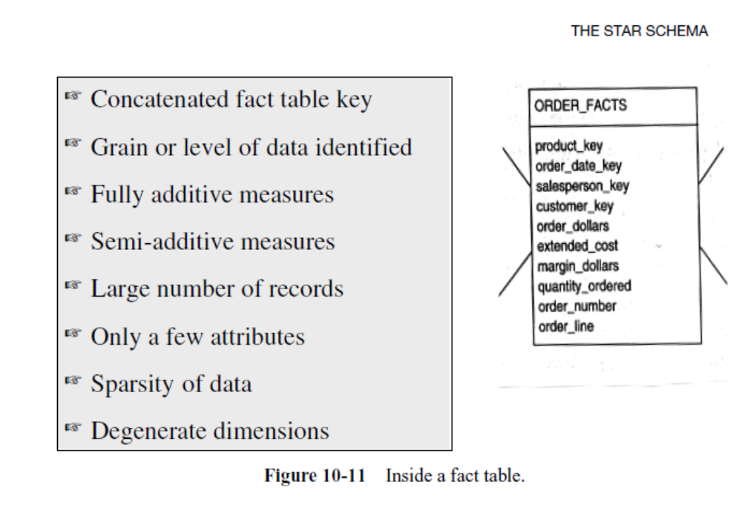

Slide 28
Dimension tables
A dimension table consists of columns representing dimensions that provide context needed for studying the facts.
A dimension table typically stores characters that describe facts.
A dimension table normally has many columns, one per attribute of interest.
In data warehousing, a dimension table is one of the companion tables to a fact table in star scheme. Different from fact table that contains measures or business facts, dimension table contains the textual descriptor of the business.
The fields of dimension table are designed to satisfy two important requirements:
  Query constraining / grouping / filtering.
  Report labeling

Slide 29
Dimension table characteristics.
a dimension table characteristics is:
Dimension table key.
  Primary key of the dimension table uniquely identifies each row in the table.
Table is wide.
  a dimension table has many columns or attributes. It is not uncommon for some dimension tables to have more than fifty attributes. Therefore, we say that the dimension table is wide. If you lay it out as a table with columns and rows, the table is spread out horizontally.

Slide 30
Dimension table characteristics
Textual attributes.
  In the dimension table you will seldom find any numerical values used for calculations. The attributes in a dimension table are of textual format . These attributes represent the textual descriptions of the components within the business dimensions. Users will compose their queries using these descriptors.
Attributes not directly related.
  Frequently you will find that some of the attributes in a dimension table are not directly related to the other attributes in the table. For example , package size is not directly related to product brand; nevertheless, package size and product brand could both be attributes of the product dimension table.

Slide 31
Dimension table characteristics
Not normalized.
  The attributes in a dimension table are used over and over again in queries. An attribute is taken as a constraint in a query and applied directly to the metrics in the fact table. For efficient query performance, it is best if the query picks up an attribute from the dimension table and goes directly to the fact table and not through other intermediary tables. If you normalize the dimension table, you will be creating such intermediary tables and that will not be efficient. Therefore, a dimension table is flattened out, not normalized.

Slide 32
Dimension table characteristics
Drilling down, rolling up.
  The attributes in a dimension table provide the ability to get to the details from higher levels of aggregation to lower levels of details.
  For example , the three attributes zip, city, and state form a hierarchy. You may get the total sales by state, then drill down to total sales by city, and then by zip. Going the other way, you may first get the totals by zip, and then roll up to totals by city and state.
Fewer number of records.
  A dimension table typically has fewer number of records or rows than the fact table. A product dimension table for an automaker may have just 500 rows. On the other hand, the fact table may contain millions of rows.

Slide 33
Dimension table characteristics
Multiple hierarchies.
  In the example of the customer dimension, there is a single hierarchy going up from individual customer to zip, city, and state. But dimension tables often provide for multiple hierarchies, so that drilling down may be performed along any of the multiple hierarchies. Take for example a product dimension table for a department store. In this business, the marketing department may have its way of classifying the products into product categories and product departments. On the other hand, the accounting department may group the products differently into categories and product departments. So in this case, the product dimension table will have the attributes of marketing–product–category, marketing–product–department,finance–product–category, and finance–product–department.

Slide 34
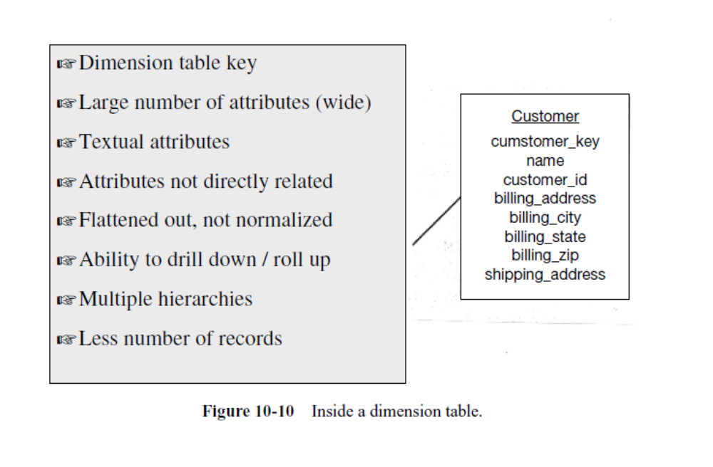

Slide 35
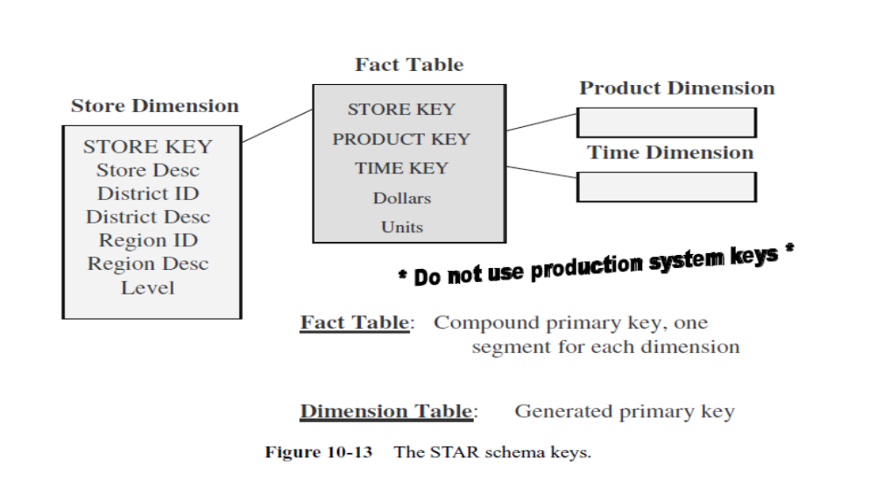
STAR SCHEMA KEYS
Figure 10-13 illustrates how the keys are formed for the dimension and fact tables.

Slide 36
Primary Keys
Each row in a dimension table is identified by a unique value of an attribute designated as the primary key of the dimension.
Problem :
Let us see what happens if we use the operational system product code as the primary key for the product dimension table.
The data warehouse contains historic data. Assume that the product code gets changed in the middle of a year, because the product is now stored in a different warehouse of the company. So we have to change the product code in the data warehouse. If the product code is the primary key of the product dimension table, then the newer data for the same product will reside in the data warehouse with different key values. This could cause problems if we need to aggregate the data from before the change with the data from after the change to the product code. What really has caused this problem? The problem is the result of our decision to use the operational system key as the key for the dimension table.

Slide 37
Surrogate keys in dimension tables
It is critical that primary key’s value of a dimension table remain unchanged. And it is highly recommended that all dimension tables use surrogate keys as primary keys. Surrogate keys are key generated and manage inside data warehouse rather than keys extracted from data source systems.
There are several advantages of using surrogate keys in dimension tables:
  Performance –Join processing between dimension tables and fact table is much more efficient by using single field surrogate key.
  In term of data acquisition, surrogate key allows integrate data from multiple data sources even if they lack consistent source keys.
  Keep track of changes in dimension field values in dimension table.
Surrogate key must be used as primary keys of dimension tables to enable the dimension tables to be shared easier.

Slide 38
Foreign Keys
Each dimension table is in a one-to-many relationship with the central fact table.
primary key of each dimension table must be a foreign key in the fact table.
Let us reexamine the primary keys for the fact tables. There are three options:
A single compound primary key whose length is the total length of the keys of the individual dimension tables.
  Under this option, in addition to the compound primary key, the foreign keys must also be kept in the fact table as additional attributes.
  This option increases the size of the fact table.

Slide 39
Foreign Keys
Concatenated primary key that is the concatenation of all the primary keys of the dimension tables.
  Here you need not keep the primary keys of the dimension tables as additional attributes to serve as foreign keys.
  The individual parts of the primary keys themselves will serve as the foreign keys.
3. A generated primary key independent of the keys of the dimension tables. In addition to the generated primary key, the foreign keys must also be kept in the fact table as additional attributes. This option also increases the size of the fact table . In practice, option (2) is used in most fact tables. This option enables you to easily relate the fact table rows with the dimension table rows.

Slide 40
ADVANTAGES OF THE STAR SCHEMA
1) Easy for Users to Understand
Users of decision support systems such as data warehouses are different. The users should know what to ask for.
The STAR schema reflects exactly how the users think and need data for querying and analysis. They think in terms of significant business metrics.
The fact table contains the metrics. The users think in terms of business dimensions for analyzing the metrics
  Example :When you explain to the users that the units of product A are stored in the fact table and point out the relationship of this piece of data to each dimension table, the users readily understand the connections. That is because the STAR schema defines the join paths in exactly the same way users normally visualize the relationships.

Slide 41
2) Optimizes Navigation
In a database schema, what is the purpose of the relationships or connections among the data entities? The relationships are used to go from one table to another for obtaining the information you are looking for. The relationships provide the ability to navigate through the database. You hop from table to table using the join paths.
If the join paths are numerous and convoluted, your navigation through the database gets difficult and slow. On the other hand, if the join paths are simple and straightforward, your navigation is optimized and becomes faster.
A major advantage of the STAR schema is that it optimizes the navigation through the database. Even when you are looking for a query result that is seemingly complex, the navigation is still simple and straightforward.

Slide 42
3) Most Suitable for Query Processing
Irrespective of the number of dimensions that participate in the query and irrespective of the complexity of the query, every query is simply executed first by selecting rows from the dimension tables using the filters based on the query parameters and then finding the corresponding fact table rows.
This is possible because of the simple and straightforward join paths and because of the very arrangement of the STAR schema.
There is no intermediary maze to be navigated to reach the fact table from the dimension tables.
Another important aspect of data warehouse queries is the ability to drill down or roll up.
Drill down is a process of further selection of the fact table rows. Going the other way, rolling up is a process of expanding the selection of the fact table rows.

Slide 43
4) STARjoin and STARindex
The STAR schema allows the query processor software to use better execution plans. It enables specific performance schemes to be applied to queries. The STAR schema arrangement is eminently suitable for special performance techniques such as the STARjoin and the STARindex.
STARjoin is a high-speed, single-pass, parallelizable, multitable join. It can join more than two tables in a single operation. This special scheme boosts query performance.
STARindex is a specialized index to accelerate join performance. These are indexes created on one or more foreign keys of the fact table. These indexes speed up joins between the dimension tables and the fact table.

Slide 44
CHAPTER SUMMARY
The components of the dimensional model are derived from the information packages in the requirements definition.
The STAR schema used for data design is a relational model consisting of fact and dimension tables.
The fact table contains the business metrics or measurements; the dimension tables contain the business dimensions. Hierarchies within each dimension table are used for drilling down to lower levels of data.
STAR schema advantages are that it is easy for users to understand optimizes navigation, is most suitable for query processing, and enables specific performance schemes.

Slide 45


Slide 46
Example : STAR schema for orders analysis
Figure 10-7 shows this simple STAR schema. It consists of the orders fact table shown in the middle of the schema diagram. Surrounding the fact table are the four dimension tables of customer, salesperson, order date, and product.
The users in the marketing department will analyze the orders using dollar amounts, cost, profit margin, and sold quantity. This information is found in the fact table of the structure. The users will analyze these measurements by breaking down the numbers in combinations by customer, salesperson, date, and product.
When you look at the order dollars, the STAR schema structure answers the questions of what, when, by whom, and to whom. From the STAR schema, the users can easily visualize the answers to these questions: For a given amount of dollars, what was the product sold? Who was the customer? Which salesperson brought the order? When was the order placed?

Slide 47
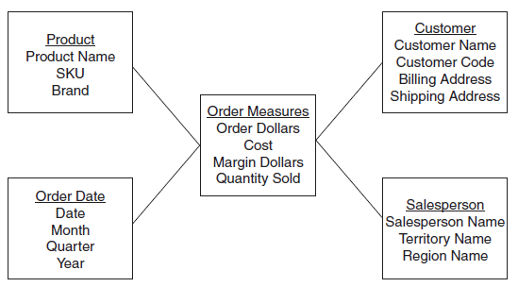
Example : STAR schema for orders analysis
Figure 10-7 Simple STAR schema for orders analysis.
Notes:
سوف يقوم المستخدمين في إدارة التسويق من تحليل أوامر باستخدام كميات الدولار والتكلفة وهامش الربح، والكمية المباعة. تم العثور على هذه المعلومات في الجدول حقيقة للهيكل

Slide 48
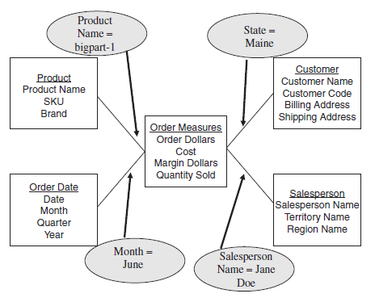
When a query is made against the data warehouse, the results of the query are produced by joining one of more dimension tables with the fact table. The joins are between the fact table and individual dimension tables. The relationship of a particular row in the fact table is with the rows in each dimension table. These individual relationships are clearly shown as the spikes of the STAR schema.
Figure 10-8 Understanding a query from the STAR schema.

Slide 49
Figure 10-8 shows how this query is formulated from the STAR schema. Constraints and filters for queries are easily understood by looking at the STAR schema.
A common type of analysis is the drilling down of summary numbers to get at the details at the lower levels.
The following query: Show me the total quantity sold of product brand big parts to customers in the northeast region for year 2008.
In the next step of the analysis, the marketing department now wants to drill down to the level of quarters in 2008 for the northeast region for the same product brand, big parts.
Next, the analysis goes down to the level of individual products in that brand.
Finally, the analysis goes to the level of details by individual states in the northeast region. The users can easily discern all of this drill-down analysis by reviewing the STAR schema.

Slide 50
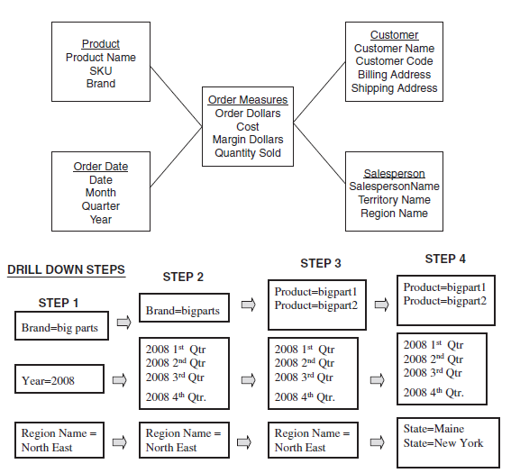
Refer to Figure 10-9 to see how the drill down is derived from the STAR schema.
Figure 10-9 Understanding drill-down analysis from the STAR schema.

